Slide 1
THE FRAGILE ECONOMICS OF CHILD CARE: AN OVERVIEW OF NEW HAMPSHIRE DATA
PRESENTED BY NICOLE HELLER, PHD
SENIOR POLICY ANALYST
NEW HAMPSHIRE ALLIANCE OF EARLY CHILDHOOD COALITIONS CONVENING
MAY 13, 2024

Slide 2
CURRENT STATE OF NEW HAMPSHIRE’S CHILD CARE SECTOR
Child care is unaffordable to most NH families
In 2023, tuition for center-based care for an infant averaged $17,250. Families paid nearly $32,000 for two children under 5.
Not enough child care slots available in NH to meet demand
There was an annual shortage of roughly 8,400 child care slots between 2018-2022
Collective staffing vacancy of 26 percent
NH child care workers do not make livable wages, and many do not have benefits
A typical NH child care worker earned roughly $32,500 in 2023. The federal poverty guideline for a family of 4 in 2023 was $30,000.
U.S. Department of the Treasury reported profit margins for child care providers were usually < 1 percent
Note: Relative to low profit margins of child care providers, the U.S. Department of the Treasury identified a 2011 analysis from the Federal Reserve Bank of Minneapolis as a research source.
Sources: Child Care Aware of America, NHFPI analysis of U.S. Census Bureau American Community Survey data, U.S. Bureau of Labor Statistics, U.S. Department of the Treasury.

Slide 3
THE PRICE OF CHILD CARE

Slide 4
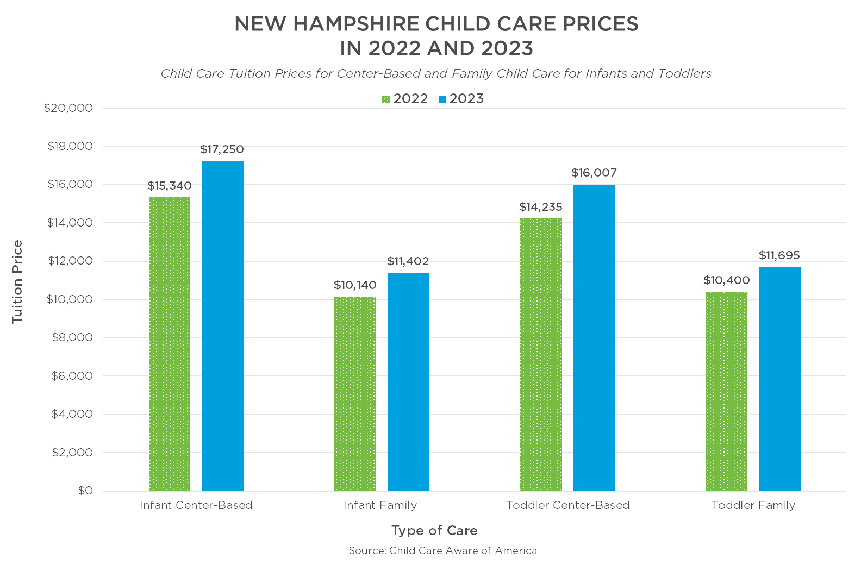
CHILD CARE PRICES INCREASED ABOUT 12 PERCENT FROM 2022 TO 2023

Slide 5
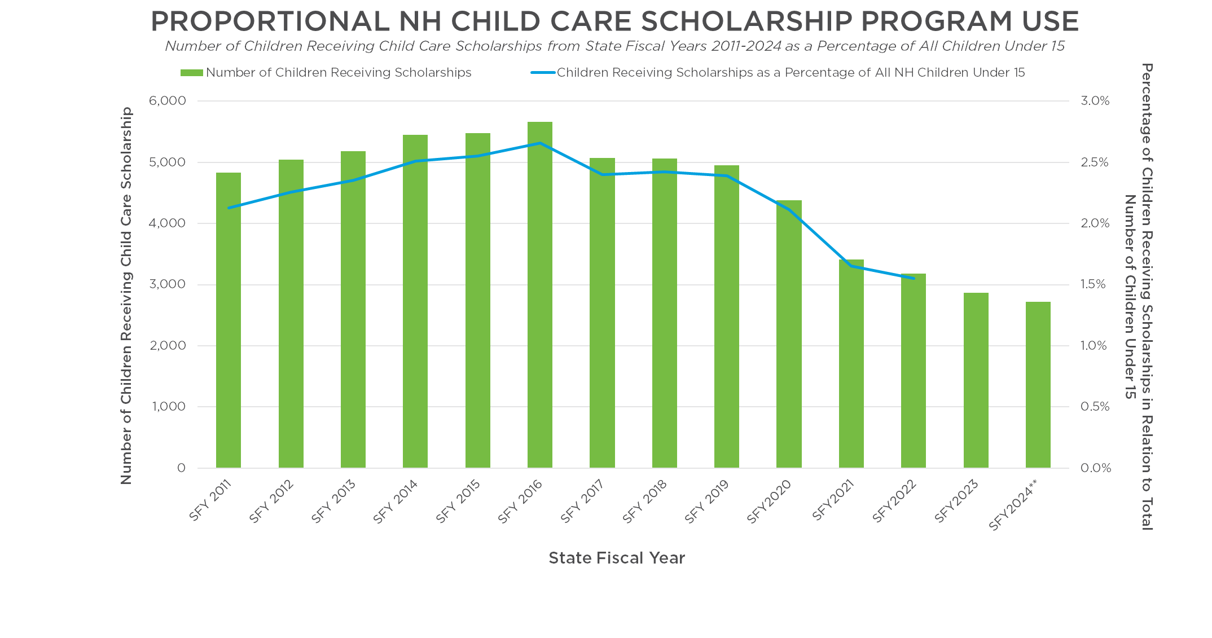
PERCENTAGE OF CHILDREN RECEIVING SCHOLARSHIPS HAS DECREASED SINCE 2016
Note: Percentages created using U.S. Census Bureau's Annual Estimates of Resident Population that are calculated for July 1 of the calendar year. State Fiscal Years run July 1 of previous calendar year to June 30 of current calendar year. **July 2023-February 2024.
Sources: Child care employment related cases in New Hampshire Department of Health and Human Services' Operating Statistics Dashboard submitted for Fiscal Meeting March 2024. Data as of February 29, 2024. U.S. Census Bureau's Annual Estimates of the Resident Population 2011-2022.

Slide 6
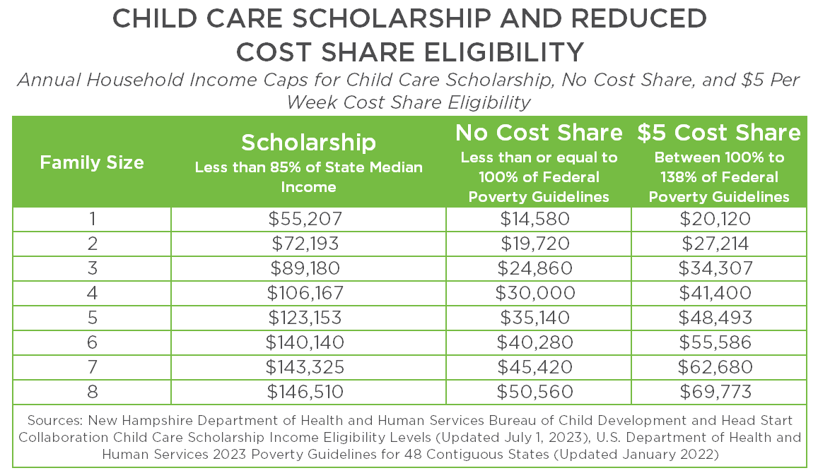
NEW HAMPSHIRE CHILD CARE SCHOLARSHIP ELIGIBLITY EXPANSION
Notes:
Two working adults and 1 child or a single adult with 2 children

Slide 7
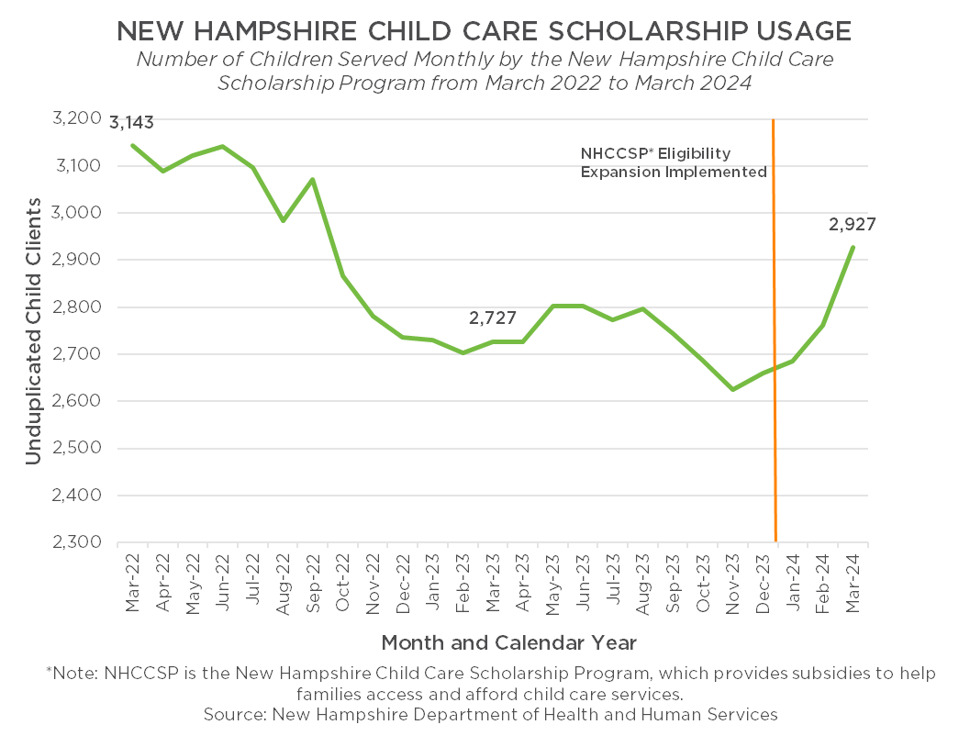
TRENDING INCREASE IN CHILD CARE SCHOLARSHIP USE
Notes:
Two working adults and 1 child or a single adult with 2 children

Slide 8
CHILD CARE WORKER WAGES

Slide 9
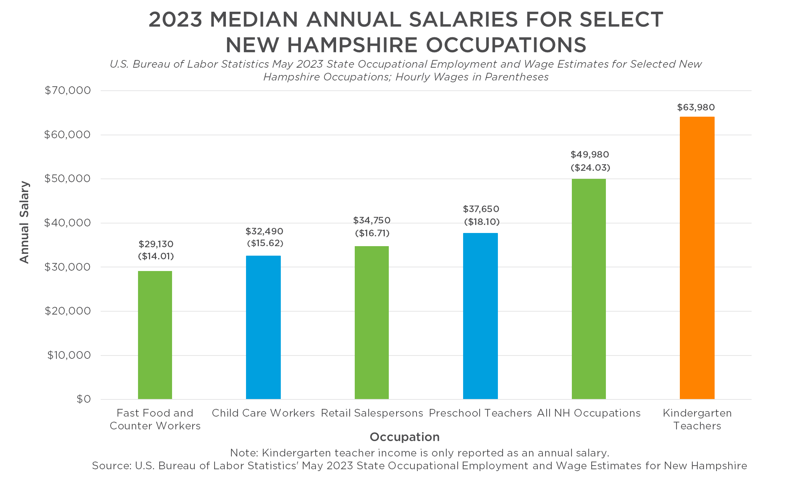
NEW HAMPSHIRE EARLY CHILDHOOD EDUCATORS’ WAGES ARE NOT COMPETITIVE

Slide 10
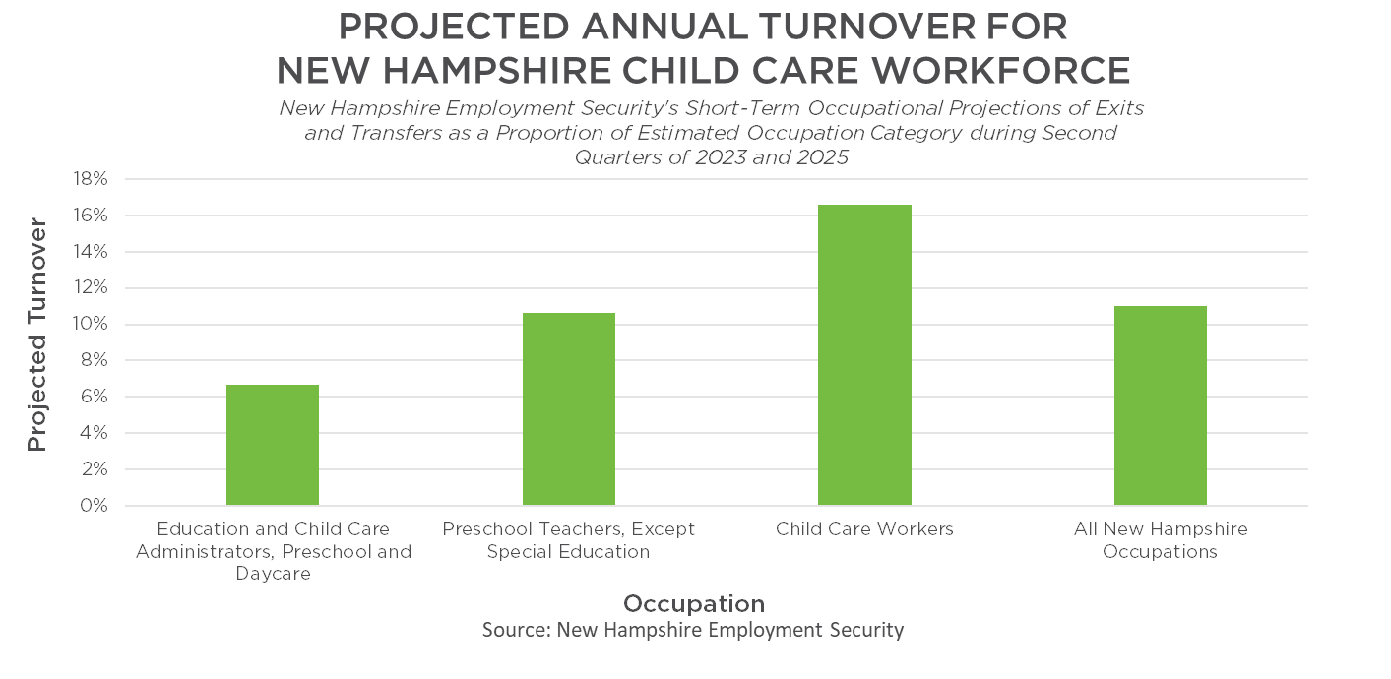
PROJECTED HIGH TURNOVER AMONG CHILD CARE WORKERS

Slide 11
ONE-TIME FEDERAL AND STATE INVESTMENTS

Slide 12
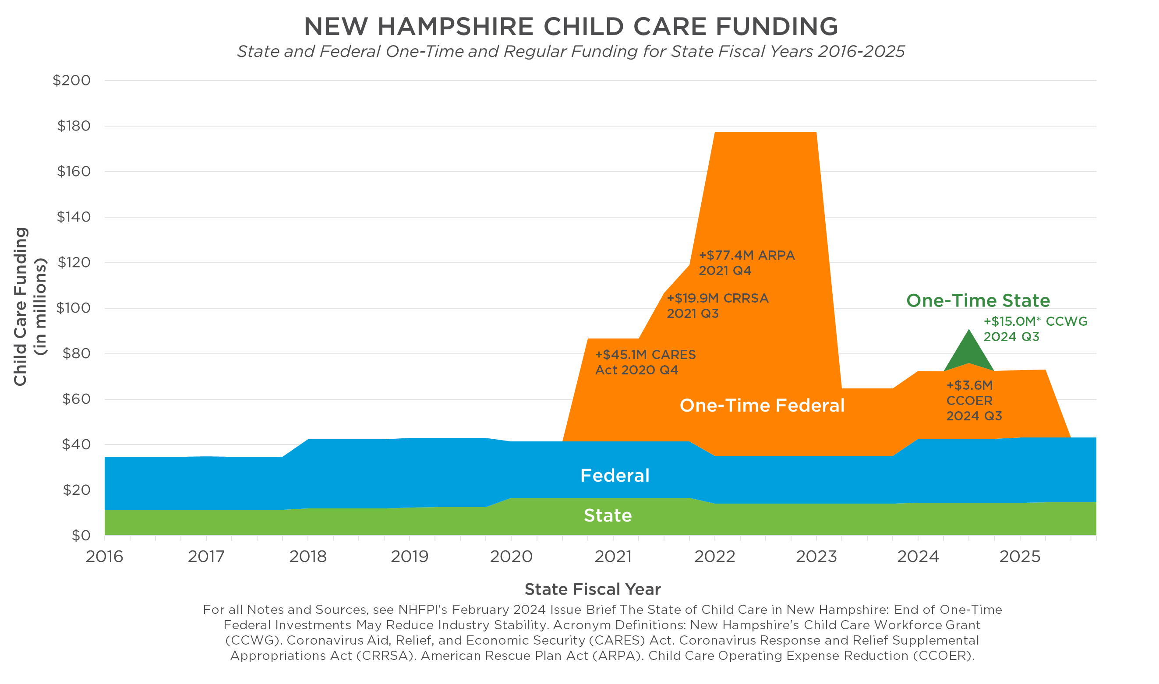
END OF ONE-TIME FEDERAL INVESTMENTS MAY REDUCE INDUSTRY STABILITY

Slide 13
KEY POINTS
System is not working well for anyone:
Child care is unaffordable to the majority of families
Low wages for workforce; poor retention
Program revenues do not cover “true cost of care”
Small, if any, profits for providers
End of one-time funding for the sector

Slide 14
ADDITIONAL RESOURCES
Issue Brief: The State of Child Care in New Hampshire: End of One-Time Federal Investments May Reduce Industry Stability – February 2, 2024 https://nhfpi.org/resource/the-state-of-child-care-in-new-hampshire-end-of-one-time-federal-investments-may-reduce-industry-stability/
Blog: New Hampshire Child Care Scholarship Eligibility to be Expanded in 2024, Provider Reimbursement Rates Increased – January 19, 2024 https://nhfpi.org/blog/new-hampshire-child-care-scholarship-eligibility-to-be-expanded-in-2024-provider-reimbursement-rates-increased/
Fact Sheet: Child Care in New Hampshire: High Price, Low Supply – October 13, 2023 https://nhfpi.org/resource/child-care-in-new-hampshire-high-price-low-supply/

Slide 15
ADDRESS: 100 North Main Street, Suite 400, Concord, NH 03301
PHONE: 603.856.8337
WEBSITE: www.nhfpi.org
EMAIL: info@nhfpi.org
TWITTER: @NHFPI
FACEBOOK: NewHampshireFiscalPolicyInstitute
Notes:
Any questions?

